Slide 1
Simple Sorting
Bubble Sort
Selection Sort
Insertion Sort
Merge Sort
Notes:
Merge Sort

Slide 2
Notion of Sorting
Input
    list containing unordered Comparables
      Duplicates are allowed
Output
    A sorted list containing the same items
Comparison based sorting
    Only two operations allowed
      Comparison between a pair of items
      Swap two items

Slide 3
A Few Sorting Applications
Sorting information
    Email by date, subject, sender, ...
    Files by name, size, type, ...
Selection problem
    Find the k-th largest
    Find the median
Efficient search
    Binary search on sorted data
Finding duplicates
Greedy algorithms
    Explore k highest scoring paths first

Slide 4
Sorting Algorithms
They are legion!
Simple
  Bubble sort, Selection sort, Insertion sort, ...
Complex
  Shell sort, Heap sort, Merge sort, Quick sort, Radix sort, ...

Slide 5
Some Terminology
Sort key
  Value used to sort the elements of a collection
  May be primitive or structured (primary and secondary keys)

Slide 6
Some Terminology
Total ordering
  The elements of the collection are said to be totally ordered if
  for any elements x, y, and z from the collection:
  x == x reflexive
  (x ≤ y and y ≤ z) => x ≤ z transitive
  (x ≤ y and y ≤ x) => x == y asymmetric
  ie. Total means either x ≤ y or y ≤ x

Slide 7
Some Terminology
Increasing order (also called sorted or ascending order)
  The elements in the sorted collection are:
  unique (no duplicates) and
  ordered such that
  e₁ < e₂ < e₃ < …. < e_{n}
  e.g. 2 < 5 < 16

Slide 8
Some Terminology
Non-decreasing order
  The elements in the sorted collection
  may contain duplicates and
  are sorted such that
  e₁ ≤ e₂ ≤ e₃ ≤ …. ≤ e_{n}
  e.g. 2 ≤ 5 ≤ 5 ≤ 21

Slide 9
Some Terminology
Decreasing order (also called reverse sorted or descending order)
  The elements in the sorted collection are
  unique (no duplicates) and
  ordered such that
e₁ > e₂ > e₃ > …. > e_{n}
  e.g. 21 > 16 > 5 > 2

Slide 10
Some Terminology
Non-increasing order
  The elements in the sorted collection
  may contain duplicates and
  are sorted such that
  e₁ ≥ e₂ ≥ e₃ ≥ …. ≥ e_{n}
  e.g. 21 ≥ 5 ≥ 5 ≥ 2

Slide 11
Some Terminology
Stable sort
  Duplicates from the unsorted collection appear in the same relative order in the sorted collection.
  If e_{i} == e_{j} and i < j in the unsorted sequence,
  then e_{i} appears before e_{j} in the sorted sequence.
  In the following example, the subscripts to 5 show their relative order in the unsorted sequence.
  Unsorted collection: 5₁ 2 6 5₂ 4
  Sorted, stable: 2 4 5₁ 5₂ 6
  Sorted, not stable: 2 4 5₂ 5₁ 6

Slide 12
Some Terminology
In-place sort
  The extra space required to store the data during the sort is independent of the size of the input
  Swapping references instead of elements => in-place sort
  The space complexity of such an algorithm is O(1)

Slide 13
Bubble sort
Traversal from the low end of the array
Compare elements by pairs
  left element > right element => swap elements
Start again
  Except largest element is now at the high end
  => Traversal from the low end to high end - 1
  After k steps, traversal from the low end to high end - k

Slide 14
Bubble Sort
Visualisation time!
https://visualgo.net/sorting

Slide 15
Selection sort
Initial configuration
    input array logically split into 2 parts: unsorted and sorted
Pseudocode
  while the size of the unsorted part is greater than 1
  find the position of the smallest element in the unsorted part
  move this smallest element into the last position of the sorted part
  decrement the size of the unsorted part by 1
Invariant
  The elements of the sorted part are ordered

Slide 16
Selection Sort
Visualisation time!
https://visualgo.net/sorting

Slide 17
Insertion Sort
Initial configuration
    input array logically split into 2 parts: unsorted and sorted
Pseudocode
  while the size of the unsorted part is greater than 0
  let the target element be the first element in the unsorted part
  find target’s insertion point in the sorted part
  make place at insertion point by shifting all larger elements
  insert the target in its final, sorted position
Invariant
  The elements of the sorted part are ordered

Slide 18
Insertion Sort
Visualisation time!
https://visualgo.net/sorting

Slide 19
Time Complexity – Comparisons
Unordered part has size N initially
Traversal 1 => N-1 comparisons
Traversal 2 => N-2 comparisons
...
...
(N-1)+(N-2)+...+1 = N*(N-1)/2 comparisons
O(N²)

Slide 20
Time Complexity – Swaps
Bubble swaps as it compares
  can incur as many as N*(N-1)/2 swaps
  O(N²)
Selection only swaps to bring elements to their final place
  Does not move elements orthogonal to the swap
  Worst-case number of swaps is N-1
  O(N)
Insertion swaps to bring elements to their final place
  Also swaps previously ordered elements
  Worst-case number of swaps is N*(N-1)/2
  O(N²)

Slide 21
Time Complexity
Bubble
  O(N²) + O(N²)
Selection
  O(N²) + O(N)
Insertion
  O(N²) + O(N²)
  O(N²)

Slide 22
Observations About Insertion Sort
On average, insertion sort is inefficient
  Reason: it moves values just one position at a time
Insertion sort is efficient if the input is "almost sorted"
What is the total number of comparisons/swaps insertion sort incurs if the input is sorted?

Slide 23
Merge Sort
7 2 ⏐ 9 4 → 2 4 7 9
7 ⏐ 2 → 2 7
9 ⏐ 4 → 4 9
7 → 7
2 → 2
9 → 9
4 → 4
Merge Sort
Notes:
Merge Sort

Slide 24
Divide-and-Conquer
Divide-and conquer is a general algorithm design paradigm:
  Divide: divide the input data S in two disjoint subsets S₁ and S₂
  Recur: solve the subproblems associated with S₁ and S₂
  Conquer: combine the solutions for S₁ and S₂ into a solution for S
The base case for the recursion are subproblems of size 0 or 1
Merge-sort is a sorting algorithm based on the divide-and-conquer paradigm
Like heap-sort
  It has O(n log n) running time
Unlike heap-sort
  It does not use an auxiliary priority queue
  It accesses data in a sequential manner (suitable to sort data on a disk)
Merge Sort

Slide 25
Merge-Sort
Merge-sort on an input sequence S with n elements consists of three steps:
  Divide: partition S into two sequences S₁ and S₂ of about n/2 elements each
  Recur: recursively sort S₁ and S₂
  Conquer: merge S₁ and S₂ into a unique sorted sequence
Algorithm mergeSort(S)
Input sequence S with n elements
Output sequence S sorted
  according to C
  if S.size() > 1
  (S₁, S₂) ← partition(S, n/2)
  mergeSort(S₁)
  mergeSort(S₂)
  S ← merge(S₁, S₂)
Merge Sort

Slide 26
Merging
Key to Merge Sort
  Merging two sorted lists into one
  Example:
L₁ = { 3 8 9 } L₂ = { 1 5 7 }
merge(L₁, L₂) = { 1 3 5 7 8 9 }

Slide 27
Merging (cont.)
X:
3 | 10 | 23 | 54
Y:
1 | 5 | 25 | 75
Result:

Slide 28
Merging (cont.)
X:
3 | 10 | 23 | 54
Y:
 | 5 | 25 | 75
Result:
1

Slide 29
Merging (cont.)
X:
 | 10 | 23 | 54
Y:
 | 5 | 25 | 75
Result:
1 | 3

Slide 30
Merging (cont.)
X:
 | 10 | 23 | 54
Y:
 |  | 25 | 75
Result:
1 | 3 | 5

Slide 31
Merging (cont.)
X:
 |  | 23 | 54
Y:
 |  | 25 | 75
Result:
1 | 3 | 5 | 10

Slide 32
Merging (cont.)
X:
 |  |  | 54
Y:
 |  | 25 | 75
Result:
1 | 3 | 5 | 10 | 23

Slide 33
Merging (cont.)
X:
 |  |  | 54
Y:
 |  |  | 75
Result:
1 | 3 | 5 | 10 | 23 | 25

Slide 34
Merging (cont.)
X:
Y:
 |  |  | 75
Result:
1 | 3 | 5 | 10 | 23 | 25 | 54

Slide 35
Merging (cont.)
X:
Y:
Result:
1 | 3 | 5 | 10 | 23 | 25 | 54 | 75

Slide 36
Merging Two Sorted Sequences
The conquer step of merge-sort consists of merging two sorted sequences A and B into a sorted sequence S containing the union of the elements of A and B
Merging two sorted sequences, each with n/2 elements and implemented by means of a doubly linked list, takes O(n) time
Algorithm merge(A, B)
Input sequences A and B with
n/2 elements each
Output sorted sequence of A ∪ B
  S ← empty sequence
  while ¬A.isEmpty() ∧ ¬B.isEmpty()
  if A.first().element() < B.first().element()
  S.addLast(A.remove(A.first()))
  else
  S.addLast(B.remove(B.first()))
  while ¬A.isEmpty() S.addLast(A.remove(A.first()))
  while ¬B.isEmpty() S.addLast(B.remove(B.first()))
  return S
Merge Sort

Slide 37
Divide And Conquer
Base case
  Merging 2 lists of 1 element each is the same as sorting them
Recursion
    Divide unsorted list in half
    Merge sort right side & left side
    Merge right and left back together

Slide 38
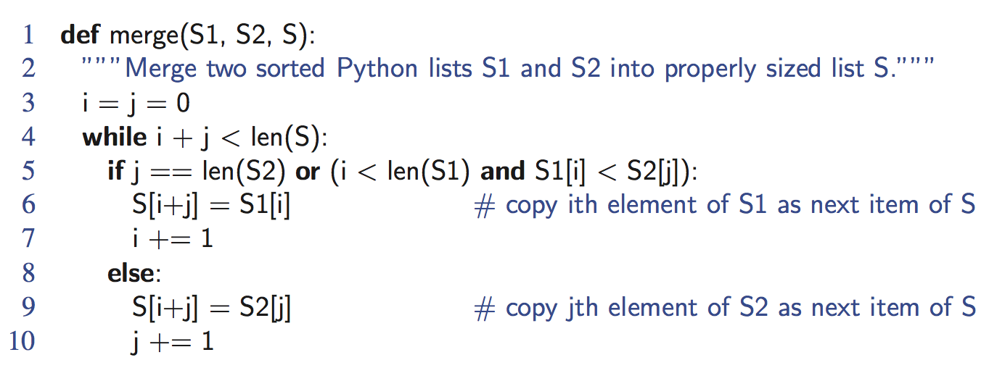
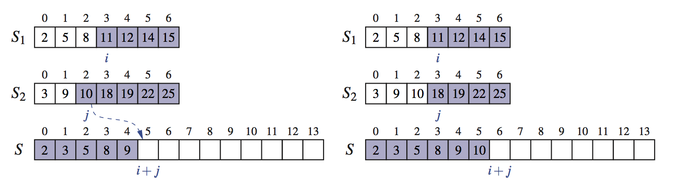
Python Merge Implementation
Merge Sort

Slide 39
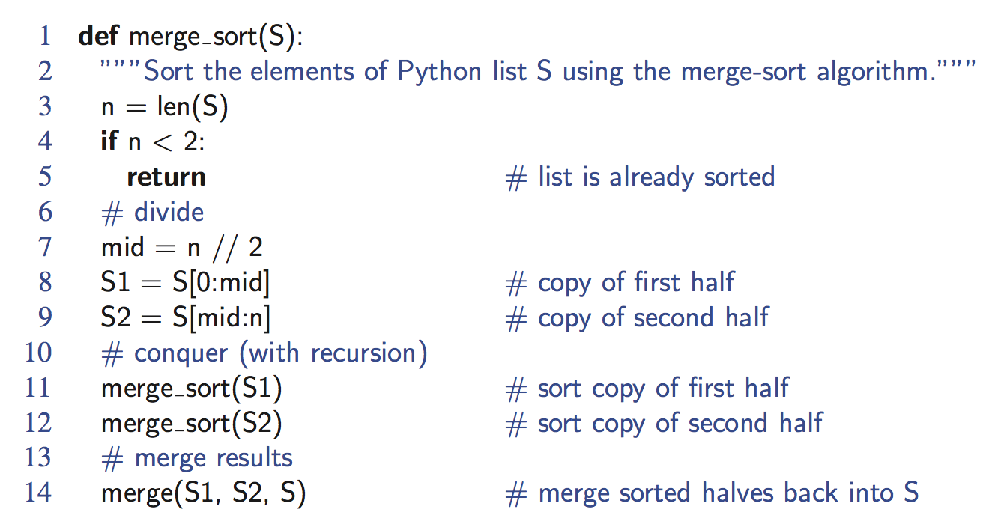
Python Merge-Sort Implementation
Merge Sort

Slide 40
Merge-Sort Tree
An execution of merge-sort is depicted by a binary tree
  each node represents a recursive call of merge-sort and stores
    unsorted sequence before the execution and its partition
    sorted sequence at the end of the execution
  the root is the initial call
  the leaves are calls on subsequences of size 0 or 1
7 2 ⏐ 9 4 → 2 4 7 9
7 ⏐ 2 → 2 7
9 ⏐ 4 → 4 9
7 → 7
2 → 2
9 → 9
4 → 4

Slide 41
Execution Example
Partition
7 2 9 4 ⏐ 3 8 6 1

Slide 42
Execution Example (cont.)
Recursive call, partition
7 2 9 4 ⏐ 3 8 6 1
7 2 ⏐ 9 4

Slide 43
Execution Example (cont.)
Recursive call, partition
7 2 9 4 ⏐ 3 8 6 1
7 2 ⏐ 9 4
7 ⏐ 2

Slide 44
Execution Example (cont.)
Recursive call, base case
7 2 9 4 ⏐ 3 8 6 1
7 2 ⏐ 9 4
7 ⏐ 2
7 → 7

Slide 45
Execution Example (cont.)
Recursive call, base case
7 2 9 4 ⏐ 3 8 6 1
7 2 ⏐ 9 4
7 ⏐ 2
7 → 7
2 → 2

Slide 46
Execution Example (cont.)
Merge
7 2 9 4 ⏐ 3 8 6 1
7 2 ⏐ 9 4
7 ⏐ 2 → 2 7
7 → 7
2 → 2

Slide 47
Execution Example (cont.)
Recursive call, …, base case, merge
7 2 9 4 ⏐ 3 8 6 1
7 2 ⏐ 9 4
7 ⏐ 2 → 2 7
9 4 → 4 9
7 → 7
2 → 2
9 → 9
4 → 4

Slide 48
Execution Example (cont.)
Merge
7 2 9 4 ⏐ 3 8 6 1
7 2 ⏐ 9 4 → 2 4 7 9
7 ⏐ 2 → 2 7
9 4 → 4 9
7 → 7
2 → 2
9 → 9
4 → 4

Slide 49
Execution Example (cont.)
Recursive call, …, merge, merge
7 2 9 4 ⏐ 3 8 6 1
7 2 ⏐ 9 4 → 2 4 7 9
3 8 6 1 → 1 3 6 8
7 ⏐ 2 → 2 7
9 4 → 4 9
3 8 → 3 8
6 1 → 1 6
7 → 7
2 → 2
9 → 9
4 → 4
3 → 3
8 → 8
6 → 6
1 → 1

Slide 50
Execution Example (cont.)
Merge
7 2 9 4 ⏐ 3 8 6 1 → 1 2 3 4 6 7 8 9
7 2 ⏐ 9 4 → 2 4 7 9
3 8 6 1 → 1 3 6 8
7 ⏐ 2 → 2 7
9 4 → 4 9
3 8 → 3 8
6 1 → 1 6
7 → 7
2 → 2
9 → 9
4 → 4
3 → 3
8 → 8
6 → 6
1 → 1

Slide 51
Analysis of Merge-Sort
The height h of the merge-sort tree is O(log n)
  at each recursive call we divide in half the sequence,
The overall amount or work done at the nodes of depth i is O(n)
  we partition and merge 2^{i} sequences of size n/2^{i}
  we make 2^{i+1} recursive calls
Thus, the total running time of merge-sort is O(n log n)
depth | #seqs | size
0 | 1 | n
1 | 2 | n/2
i | 2^{i} | n/2^{i}
… | … | …
Merge Sort

Slide 52
Complexity of MergeSort
Pass Number | Number of merges | Merge list length | # of comparisons / moves per merge
1 | 2^{k-1} or N/2 | 1 or N/2^{k} | ≤ 2¹
2 | 2^{k-2} or N/4 | 2 or N/2^{k-1} | ≤ 2²
3 | 2^{k-3} or N/8 | 4 or N/2^{k-2} | ≤ 2³
. | . | . | .
. | . | . | .
. | . | . | .
k – 1 | 2¹ or N/2^{k-1} | 2^{k-2} or N/4 | ≤ 2^{k-1}
k | 2⁰ or N/2^{k} | 2^{k-1} or N/2 | ≤ 2^{k}
k = log N

Slide 53
Complexity of MergeSort
Multiplying the number of merges by the maximum number of comparisons per merge, we get:
(2^{k-1}) 2¹ = 2^{k}
(2^{k-2}) 2² = 2^{k}
•
•
•
(2¹) 2^{k-1} = 2^{k}
(2⁰) 2^{k} = 2^{k}
k passes each
require 2^{k} comparisons (& moves) but k = log N
=> log(N) * N comparisons
O(N log N)
Drawback: MergeSort is very memory-greedy!

Slide 54
Summary of Sorting Algorithms
Algorithm | Time | Notes
selection-sort | O(n²) | slow in-place for small data sets (< 1K)
insertion-sort | O(n²) | slow in-place for small data sets (< 1K)
merge-sort | O(n log n) | fast sequential data access for huge data sets (> 1M)
Merge Sort

